Slide 1


Overwiew about the
Eurocodes

Slide 2
EN Eurocodes
The EN Eurocodes are a series of
ten European Standards,
providing a common approach
for the design of buildings and
other civil engineering works and construction products
Notes:
You remember my Weakness: Abbreviations → EN, EC …

Slide 3
Abbreviations:
EC: Eurocode
EN: European Norms (EN 1 - EN 299.999)
European Standard (english)
Europäische Norm (deutsch)
ENV: European Pre-Standard (english)
Vor-Norm (german)
CEN: Comité Européen de Normalisation (french)
European Standardisation Organisation (english)
Europäisches Komitee für Normung (german)
NDP: Nationally Determined Parameters (english)
http://eurocodes.jrc.ec.europa.eu/showpage.ph7
Notes:
What is a STANDARD?

Slide 4
European Standards EN
A Standard (French: norme, German: Norm) is a document that provides rules, guidelines or characteristics for activities or their results, for common and repeated use.
Each European Standard is identified by a unique reference code which contains the letters 'EN'.
Notes:
Back to Eurocodes! What are the Eurocodes?

Slide 5
What are the Eurocodes?
The Eurocodes are pan-European structural design codes.
There are ten Eurocodes in a total of 58 parts covering.
They cover the design of bridges, buildings, silos, tanks, pipelines, towers, masts and more.
All in all: Nearly 6.000 pages.

Slide 6
The EN Eurocodes apply to structural design of buildings and other civil engineering works including:
geotechnical aspects
structural fire design
situations including earthquakes, execution and temporary structures.
For the design of special construction works (e.g. nuclear installations, dams, etc) other provisions than those in the EN Eurocodes might be necessary.

Slide 7
There are ten structural Eurocodes, covering design principles, loading on structures, design with different materials, geotechnical design and design for earthquake resistance.

Slide 8
The ten Eurocodes are shown below:
1) EN 1990 Basis of Design: EC 0
2) EN 1991 Actions on Structures: EC 1
3) EN 1992 Design of Concrete Structures: EC 2
4) EN 1993 Design of Steel Structures: EC 3
5) EN 1994 Design of Composite Steel and Concrete Structures: EC 4
6) EN 1995 Design of Timber Structures: EC 5
7) EN 1996 Design of Masonry Structures: EC 6
8) EN 1997 Geotechnical Design: EC 7
9) EN 1998 Design of Structures for Earthquake Resistance: EC 8
10) EN 1999 Design of Aluminium Structures: EC 9

Slide 9
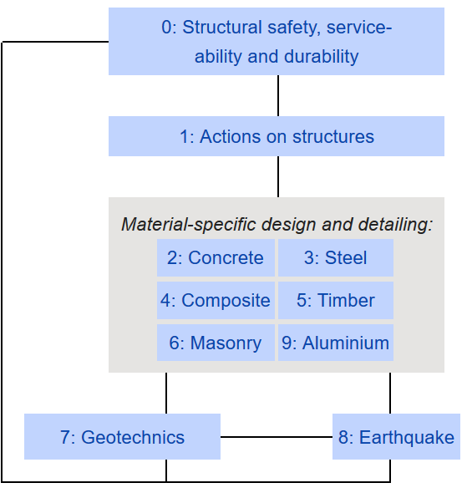
Eurocodes

Slide 10
Parts
All of the EN Eurocodes relating to materials have a Part 1-1 which covers the design of buildings and other civil engineering structures and a Part 1-2 for fire design.
The codes for concrete, steel, composite steel and concrete, and timber structures and earthquake resistance have a Part 2 covering design of bridges.
These Parts 2 should be used in combination with the appropriate general Parts (Parts 1).

Slide 11
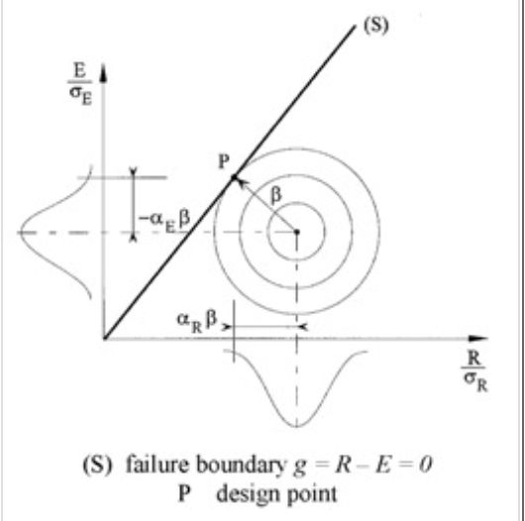
EN 1990 Basis of Design
DIN EN 1990 = EC 0: Grundlagen der Tragwerksplanung (german)
EN 1990 establishes Principles and Requirements for the safety, serviceability and durability of structures, describes the basis for their design and verification and gives guidelines for related aspects of structural reliability.

Slide 12
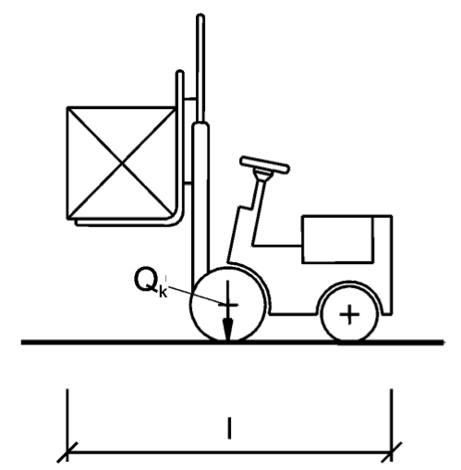
EN 1991 Actions on Structures
DIN EN 1991 = EC1: Einwirkungen auf Tragwerke
(german), (10 Parts = Teilnormen)
EN 1991 Eurocode 1 provides comprehensive information on all actions that should normally be considered in the design of buildings and other civil engineering works, including some geotechnical aspects.
It is in four main parts, the first part being divided into sub-parts that cover densities, self-weight and imposed loads; actions due to fire; snow; wind; thermal actions; loads during execution and accidental actions. The remaining three parts cover traffic loads on bridges, actions by cranes and machinery and actions in silos and tanks.

Slide 13
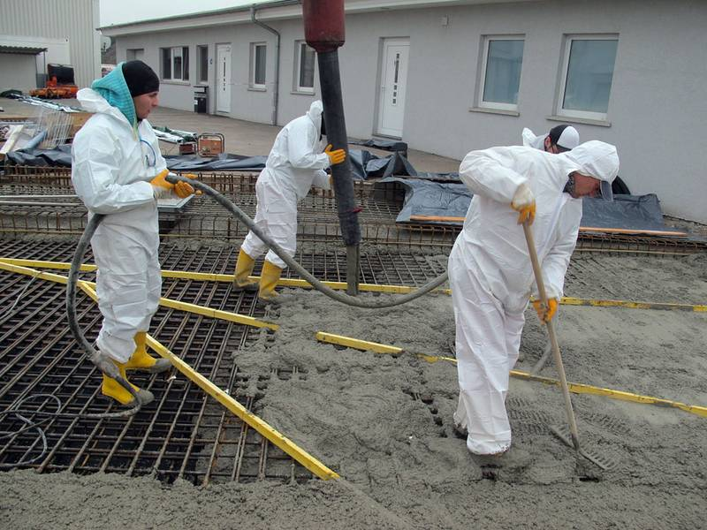
EN 1992 Design of Concrete Structures
DIN EN 1992 = EC 2: Bemessung und
Konstruktion von Stahlbeton- und Spannbeton-
tragwerken (german), (4 Parts = Teilnormen)
EN 1992 Eurocode 2 applies to the design of buildings and other civil engineering works in plain, reinforced and prestressed concrete. It complies with the principles and requirements for the safety and serviceability of structures, the basis of their design and verification that are given in EN 1990: Basis of structural design. EN Eurocode 2 is concerned with the requirements for resistance, serviceability, durability and fire resistance of concrete structures.

Slide 14
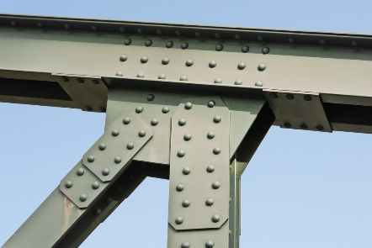
EN 1993 Design of Steel Structures
DIN EN 1993 = EC 3: Bemessung und
Konstruktion von Stahlbauten (german),
(20 Parts =Teilnormen)
EN 1993 Eurocode 3 applies to the design of buildings and other civil engineering works in steel. It complies with the principles and requirements for the safety and serviceability of structures, the basis of their design and verification that are given in EN 1990 – Basis of structural design. EN Eurocode 3 is concerned with requirements for resistance, serviceability, durability and fire resistance of steel structures.

Slide 15
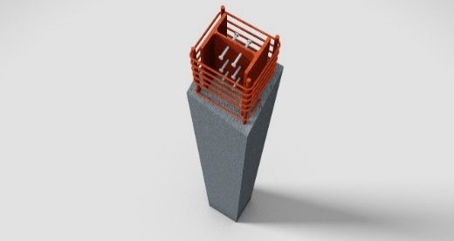
EN 1994 Design of Composite Steel and Concrete Structures
DIN EN 1994 = EC 4: Bemessung und Konstruktion
von Verbundtragwerken aus Stahl und Beton (german),
(3 Parts = Teilnormen)
EN 1994 Eurocode 4 applies to the design of composite structures and members for buildings and other civil engineering works. It complies with the principles and requirements for the safety and serviceability of structures, the basis of their design and verification that are given in EN 1990 – Basis of structural design. EN Eurocode 4 is concerned with requirements for resistance, serviceability, durability and fire resistance of composite structures.

Slide 16
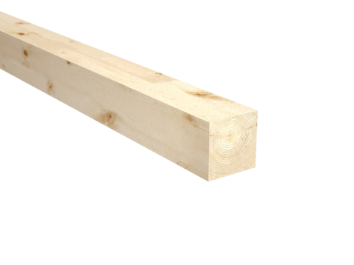
EN 1995 Design of Timber Structures
DIN EN 1995 = EC 5: Bemessung und
Konstruktion von Holzbauten (german),
(3 Parts = Teilnormen)
EN 1995 Eurocode 5 applies to the design of buildings and other civil engineering works in timber (solid timber, sawn, planed or in pole form, glued laminated timber or wood-based structural products) or wood-based panels jointed together with adhesives or mechanical fasteners.

Slide 17
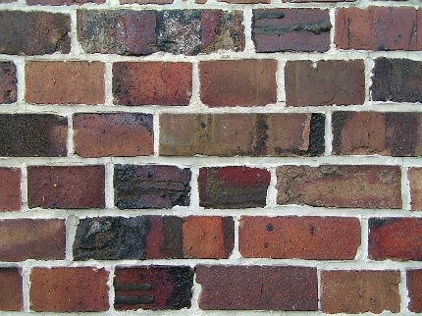
EN 1996 Design of Masonry Structures
DN EN 1996 = EC 6: Bemessung und
Konstruktion von Mauerwerksbauten (german),
(4 Parts = Teilnormen)
EN 1996 Eurocode 6 applies to the design of buildings and other civil engineering works, or parts thereof, in unreinforced, reinforced, prestressed and confined masonry. The execution is covered to the extent that is necessary to indicate the quality of the construction materials and products that should be used and the standard of workmanship on site needed to comply with the assumptions made in the design rules.

Slide 18
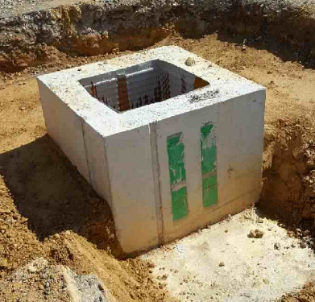
EN 1997 Geotechnical Design
DIN EN 1997 = EC 7: Entwurf, Berechnung und Bemessung in der Geotechnik (german),
(2 Parts = Teilnormen)
EN 1997 Eurocode 7 shall be applied to the geotechnical aspects of the design of buildings and other civil engineering works and shall be used in conjunction with EN 1990:2002 that establishes the principles and requirements for safety and serviceability, describes the basis of design and verification and gives guidelines for related aspects of structural reliability.

Slide 19
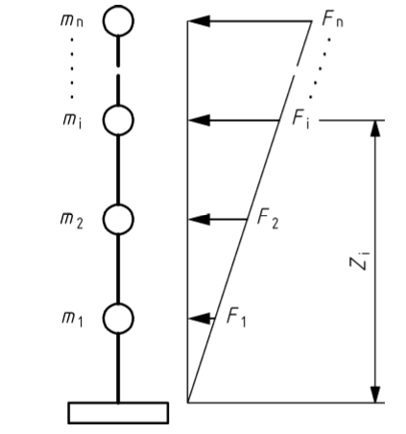
EN 1998 Design of Structures for Earthquake Resistance
DIN EN 1998 = EC 8: Auslegung von Bauwerken
gegen Erdbeben (german), (6 Parts = Teilnormen)
EN 1998 Eurocode 8 applies to the design and construction of buildings and other civil engineering works in seismic regions. Its purpose is to ensure that in the event of earthquakes human lives are protected;
damage is limited;
structures important for civil protection remain operational.

Slide 20
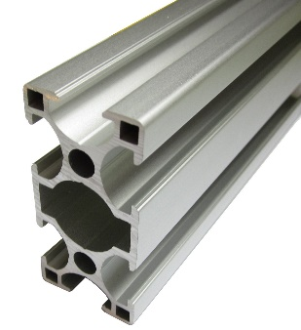
EN 1999 Design of Aluminium Structures
DIN EN 1999 = EC 9: Berechnung und
Bemessung von Aluminiumkonstruktionen (german),
(5 Parts = Teilnormen)
EN 1999 Eurocode 9 applies to the design of buildings and other civil engineering and structural works in aluminium. It complies with the principles and requirements for the safety and serviceability of structures, the basis of their design and verification that are given in EN 1990 – Basis of structural design. EN 1999 is concerned with requirements for resistance, serviceability, durability and fire resistance of aluminium structures.
Notes:
Some words to the parts

Slide 21
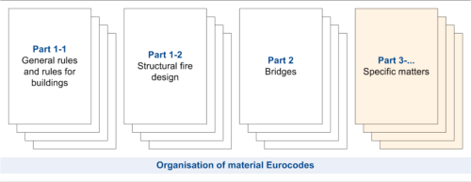
Parts
Each of the codes (except EN 1990) is divided into a number of Parts covering specific aspects of the subject. In total there are 58 EN Eurocode parts distributed in the ten Eurocodes (EN 1990 – 1999).

Slide 22
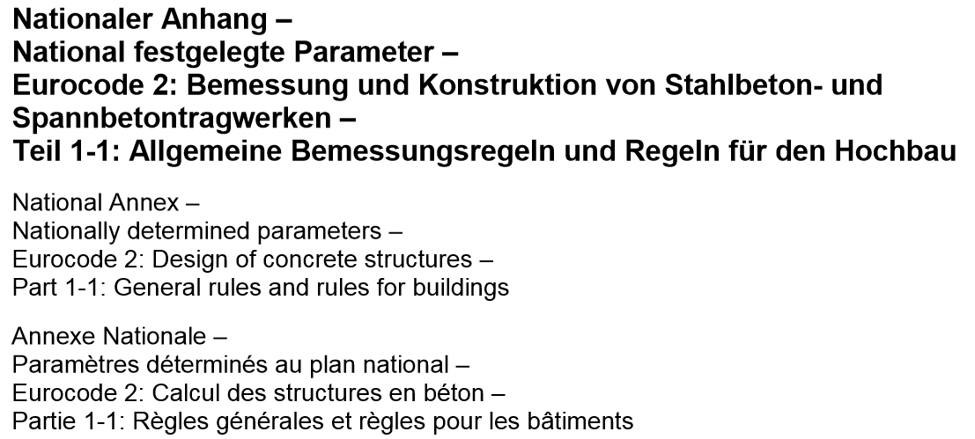
Nationally Determined Parameters = NDP
EN Eurocodes provide for National Choices full sets of recommended values, classes, symbols and alternative methods to be used as Nationally Determined Parameters (NDPs).
Each country can publish its chosen values for the NDPs in a National Annex that will accompany the Eurocode part.
Example:
EN 1992 -1-1 NA

Slide 23
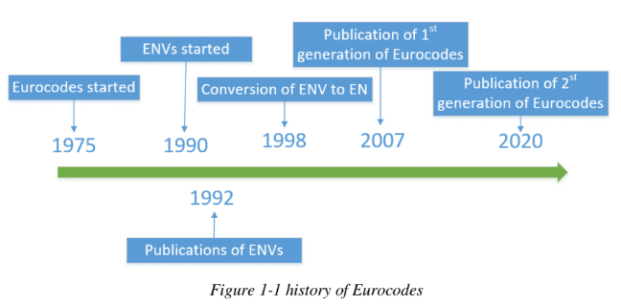
History of Eurocodes

Slide 24
Eurocodes started to be developed from 1975. It can be seen as part of the results from Treaty of Rome back in 1957, which was signed to remove barriers to trade and to harmonize technical specifications inside Europe. In 1989, European Committee for Standardization (the Comite Europeen de Normalisation, CEN) continued the work and started in the next year on developing European Pre-Standards (denoted ENVs). In 1992, ENVs were published. This Pre-Standards had 3 validity years and were co-exist with national standards. Based on the comments and advises on ENVs, conversion of ENV to EN started in 1998 by CEN members.

Slide 25
The first generation of Eurocodes were completely published at 2007, after that the implementation programme entered the Coexistence Period, during which the EN Eurocodes were used in parallel with National Standards that have the same scope.
Afterwards in more and more Europe state members, EN Eurocodes replaced the original National standards.

Slide 26
The second generation of Eurocodes will be published in 2020, in which the first generation will be amended and extend by adding new Codes such as codes for design of glass structures

Slide 27
Frequently Asked Questions
Are the Eurocodes mandatory?
Under the Public Procurement Directive, the Member States must accept designs to the Eurocodes.
Will Eurocode designs cost more to construct?
The numerous studies carried out so far indicate that the Eurocodes will have little or no effect on member sizes and quantities in common design situations.
http://www.standardsforhighways.co.uk/ha/standards/tech_info/eurocodes/faq.htm

Slide 28
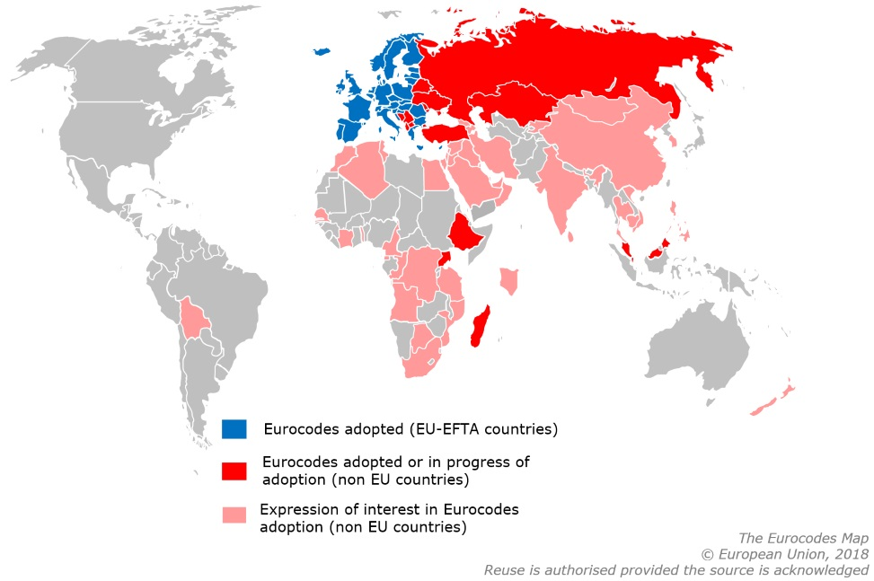
Worldwide interest in the Eurocodes
Notes:
This map you can find on the homepage http://eurocodes.jrc.ec.europa.eu/home.php

Slide 29
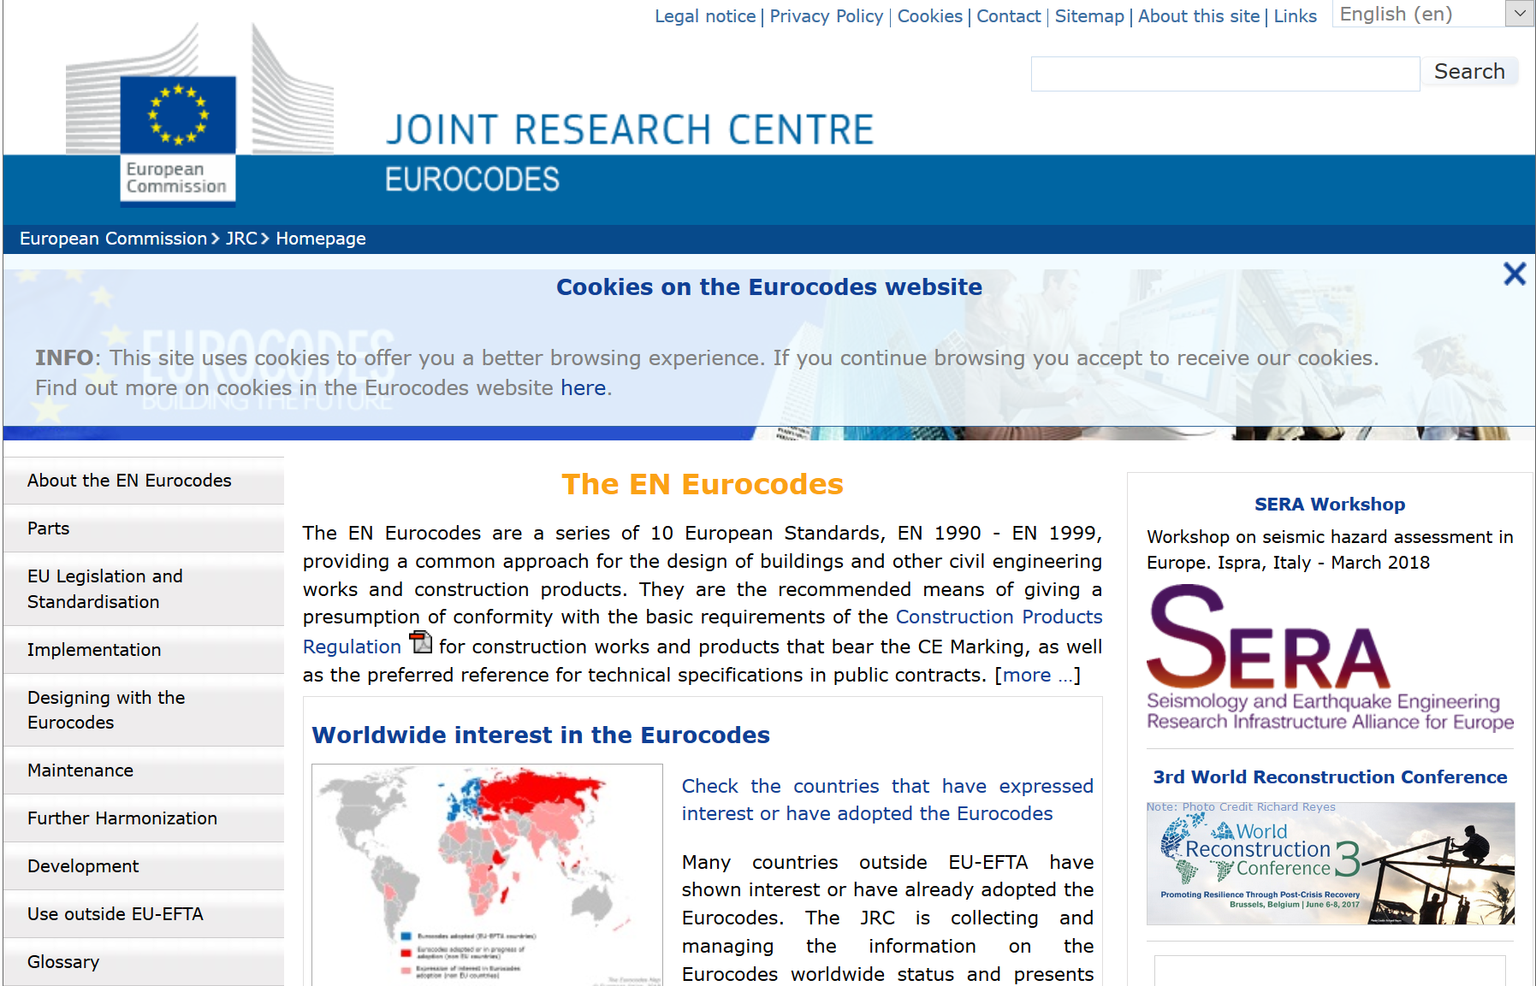
Eurocode informations: http://eurocodes.jrc.ec.europa.eu/home.php

Slide 30

Thank you
for your attention!
Dr. Helmut Nikolay, Studiendirektor, Diplom Ingenieur (FH) Coordinator of the AVEC BNT-Project and
Leader of the Fachschule für Technik, BNT Trier
Notes:
Kurzer Abriss über das Projekt AVEC BNT

